Slide 1
SCALING YOUR STARTUP
E1: Funding Your Company

Slide 2
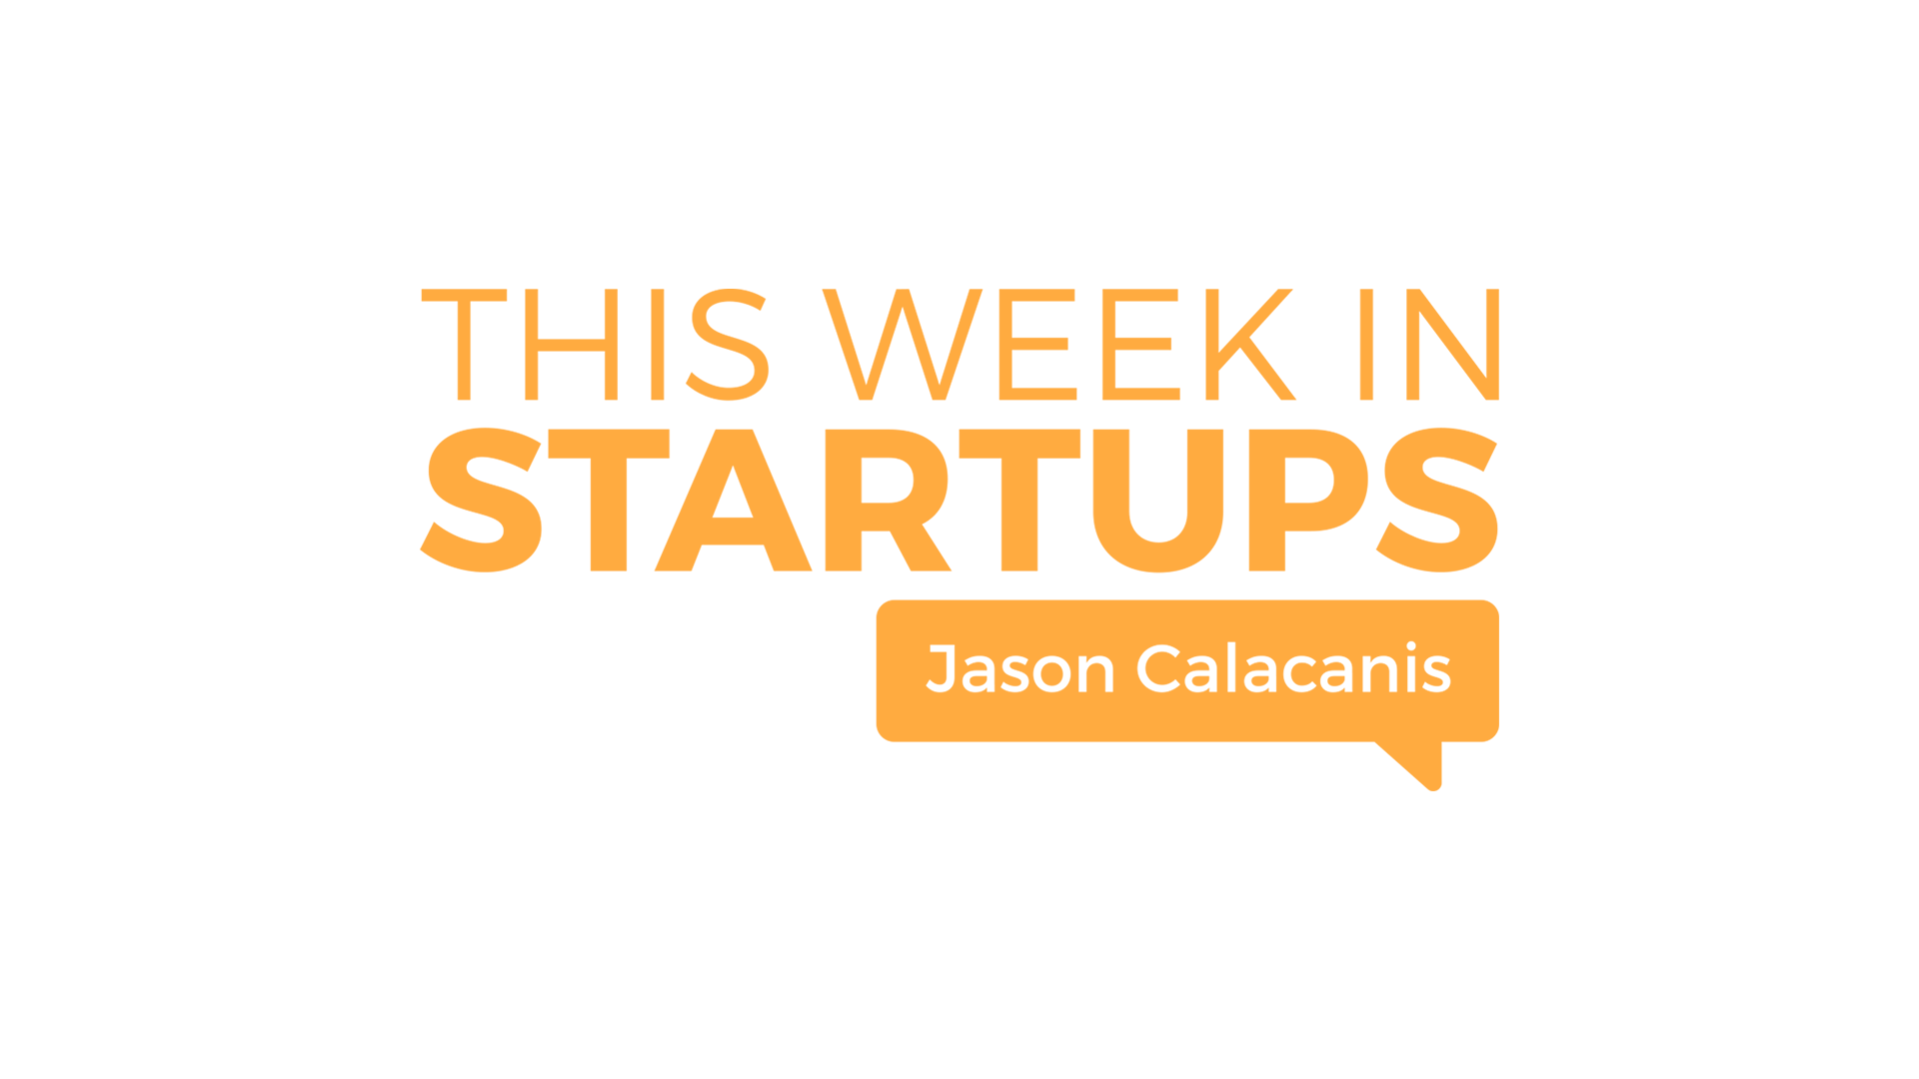
1
Bootstrapping versus fundraising
Are you a venture scale startup?
Venture scale metrics and timeline
Next: Friends & Family
Notes:
What is your burn? How much do you need? Is this a BILLION dollar business? Create 3 growth scenarios -- steady, fast, rocketship

Slide 3
2
Friends & Family
Risks and rewards to consider
SAFE agreements and convertible notes
Due diligence
Next: Angels vs. Venture

Slide 4
3
Angels versus Venture Capital
How much are you trying to raise?
Check sizes and value (beyond money)
Which investors should you target?
Syndicates
Next: Accelerators/Incubators
Notes:
Is VC or Angel right for you?

Slide 5
4
Accelerators &
Incubators
Benefits: fundraising and network
What are the best programs?
Dangers of incubator hopping
How to decide which to join
Next: Metrics
Notes:
Upside/downside. Time commitment, equity, etc.

Slide 6
5
Growth metrics investors want
Seed and Series A metrics
Marketplace, consumer, SaaS metrics
Vanity metrics and fraud
Metrics for a product build
Next: What to know prior to VC
Notes:
(i.e. 20% MOM, 10k DAUs, 5% WOW if consumer, etc.)

Slide 7
6
What to know before seeking VC
Terms, equity and growth expectations
Is it ever too soon to start fundraising?
Next: Fundraising Process

Slide 8
7
Run a process: 100+ Conversations
Investor prospects needed to close round
Goal is to have 18 months of runway
Quality of investors matter
Notes:
100+ investors -> gets a round filled
Sales Process
Intros -- existing investors, fellow founders

Slide 9
SCALING YOUR STARTUP
E2: Communication

Slide 10
1
CO-FOUNDER ALIGNMENT
Agree on the mission
Agree on roles
Understand communication style
Have Spousal/S.O. Buy-In
Next: Setting the Tone

Slide 11
2
SETTING THE TONE
WITH YOUR TEAM
Be professional
“Not in front of the kids”
Over-communicate (mission, goals, roles)
Be Transparent
Next: Small Team Communications

Slide 12
3
SMALL TEAM COMMUNICATIONS
Make a 12-Week Plan
Track Yourself Against that Plan
Use Lightweight Communications
Next: Mid-Size Team Communications
Notes:
Is VC or Angel right for you?

Slide 13
4
MID-SIZE TEAM COMMUNICATIONS
Make a 12 Month Plan
Track Yourself Against that Plan
Invest in Communication Tools
Next: Tools for Internal Communications

Slide 14
5A
TOOLS FOR INTERNAL COMMUNICATION
Establish Processes
Set Up Data Feeds
Use Checklists
Next: Tools for External Communication

Slide 15
5B
TOOLS FOR EXTERNAL COMMUNICATION
Organize Incoming Communications
Create Sequences for Prospecting and
Qualifying
Publish Documentation for Your Customers
Next: Tough Conversations

Slide 16
6
TOUGH CONVERSATIONS
Get Out of the Office
Seek Outside Help
Don’t Cross the Net
Next: Communicating with Investors

Slide 17
7
COMMUNICATING WITH INVESTORS
Send Monthly Updates
(revenue, runway, risks)
Start Board Meetings Early
Be Proactive w/ Target Investors

Slide 18
SCALING YOUR STARTUP
E3: Business Model & Turning On Revenue

Slide 19
1
Start with a business model
Have a business model from day one
First-time founder approach vs. serial founder approach
Next: How to charge

Slide 20
2
How to charge
Explain it simply - B2B & B2C Options
Startups should increase price over time
How do you increase prices over time?
Next: When to charge

Slide 21
3
When to charge
Turn on revenue earlier than you’re comfortable
Choosing how much to charge
Next: Revenue streams

Slide 22
4
Revenue streams
Answer: One
Exceptions
Next: Unit economics

Slide 23
5
Unit economics
Build a simple financial model
Margin expansion
Next: Competitors

Slide 24
6
Competitors
Main focus should be customers
Learning from your competitors
Next: Key metrics

Slide 25
7
Key metrics
Setting up metrics
Tracking & refining metrics

Slide 26
SCALING YOUR STARTUP
E4: Team

Slide 27
1
CO-FOUNDER & FIRST HIRES
Find complementary skill sets
Establish co-founder equity
<10 employees, hire generalists
>10 employees, hire specialists
Remote vs. Office
Next: In-House vs. Outsourcing

Slide 28
2
IN-HOUSE VS. OUTSOURCING
Determine what is strategic: keep in-house
Determine what is administrative and/or repeatable: outsource
Utilize SaaS vs. Contractors
Next: Hiring & HR Tools

Slide 29
3
HIRING & HR TOOLS
Create structure & a repeatable process
Be proactive and stay focused
Utilize HR tools
Next: Organizational Structure

Slide 30
4
ORGANIZATIONAL STRUCTURE
Establish and communicate ownership
Build a team org chart
Adapt as you grow
Next: Firing

Slide 31
5
FIRING
Create a performance improvement plan
Document everything
Be graceful and professional
Communicate with the team
Next: Compensation
Notes:
Is VC or Angel right for you?

Slide 32
6
COMPENSATION
“Don’t make compensation a conversation”
Do your homework
Get creative
Set employee stock option plan (ESOP)
Next: Tough Choices

Slide 33
7
TOUGH CHOICES
“The ones that got you here aren’t necessarily the ones to get you there”
Trust your gut
Avoid blurred lines
End

Slide 34
SCALING YOUR STARTUP
E5: Sales

Slide 35
1
HIRES
Be the first Evangelist
When to hire a VP or Head of Sales
Complete team with SDRs, Associates
Next: Compensation

Slide 36
2
COMPENSATION
Ensure salespeople are aligned with mission
Understand pros & cons of each method
Get creative
Next: Sales Process: Prospecting

Slide 37
3
SALES PROCESS: PROSPECTING
Identify your targets
Outsource your SDR work early
Create an autonomous sales machine
Next: Sale Process: Nurturing

Slide 38
4
SALES PROCESS: NURTURING
Emailing
Calling
Experiment, track & measure
Next: Sales Process: Closing

Slide 39
5
SALES PROCESSING: CLOSING
Obtain prospect’s budget
Identify champion & decision maker
Focus on pain points
Identify the timeframe
Identify personal motivations
Next: Upselling
Notes:
Is VC or Angel right for you?

Slide 40
6
UPSELLING
Separate sales and client success
Identify easily fillable gaps in product
Double-down on whales
Focus on creating recurring revenue
Next: Sales Tools

Slide 41
7
SALES TOOLS
Identify your sales needs & goals
Implement software for team

Slide 42
SCALING YOUR STARTUP
E6: Staying Lean

Slide 43
1
LOW BURN CULTURE
Importance of Keeping Long Runway
Cheap vs. Frugal
Next: Raising Money

Slide 44
2
RAISING MONEY
Raise with a Plan to have 18 - 24 months of Runway
Begin Raising with 6 Months of Runway
Next: HIRING HACKS FOR LONGER RUNWAY

Slide 45
3
HIRING HACKS FOR LONGER RUNWAY
Trading Equity for Salary
Founder’s Salary
Remote Colleagues
Next: FIRE FAST

Slide 46
4
FIRE FAST
Hiring is imperfect. Accept it.
Keep an eye out for early warning signs
Next: BUILDING HACKS FOR LONGER RUNWAY

Slide 47
5
BUILDING HACKS FOR LONGER RUNWAY
Utilize existing technologies
Not everything needs a developer!
Next: DECISION HACKS FOR LONGER RUNWAY

Slide 48
6
DECISION HACKS FOR LONGER RUNWAY
Find the fastest, cheapest way to validate your hypothesis
Avoid the common money pits
Next: WHEN S!$% DOESN’T GO WELL
Notes:
Is VC or Angel right for you?

Slide 49
7
WHEN S!$% DOESN’T GO WELL
Examine every cost with an investor or founder friend
Take care of yourself

Slide 50
SCALING YOUR STARTUP
E7: Fundraising: Diving into the details

Slide 51
1
THE FUNDRAISING PROCESS (NUMBERS)
Funnel Category | Number | % Dropoff | % From Top
Top of funnel | 150 | - | -
In-person meetings | 50 | 33% | 33%
Second meetings | 20 | 40% | 13%
Diligence | 10 | 50% | 6.7%
Term sheets & offers | 3 | 30% | 2%
Next: Finding Investors

Slide 52
2
FINDING INVESTORS
Target a lead
Find Investors: AngelList
Find Investors: Signal by NFX, Crunchbase
Investors to avoid
Next: The Pitch Deck

Slide 53
3
THE PITCH DECK
Send a teaser deck and a link
Tell a story
Pay for excellent design
Next: The First Meeting
Notes:
Is VC or Angel right for you?

Slide 54
4
THE FIRST MEETING
You’re in charge
Set the agenda
Prepare questions
Nail down action items
Next: After the Meeting

Slide 55
5
AFTER THE MEETING
Send FAQ
Get past associates
No response does not mean no
Do not request an intro from an investor who passes
Next: Negotiating a Term Sheet

Slide 56
6
NEGOTIATING A TERM SHEET
Take a holistic approach
Five most common terms Pre-money valuation, Liquidation preference, Board, Employee option pool, and Pro rata.
Send to advisors and legal counsel
Shop your term sheet (before signing)
Next: Due Diligence

Slide 57
7
DUE DILIGENCE
Expected timeline: Minimum 3 weeks
Create a data room
Customer references
Common red flags

Slide 58
SCALING YOUR STARTUP
E8: Marketing

Slide 59
1
METRICS
What is your startup’s North Star?
How can marketing affect that metric?
Be creative, but use data
Next: Audience

Slide 60
2
AUDIENCE
Utilize surveys
Don’t focus on features. Focus on problem.
Start email list on day 1
Be intentional about your branding
Next: Channels

Slide 61
3
CHANNELS
Online, digital Website, social, email, SEO/SEM, PPC
Word of mouth
Guerilla marketing, IRL
Next: Content

Slide 62
4
CONTENT
Blogs
Video
Social media
Podcasts
Next: Retargeting

Slide 63
5
RETARGETING
Pixel tag your websites
Setup at least 7 touch points for prospects
Personalize your ads
Get clever
Next: Conversion
Notes:
Is VC or Angel right for you?

Slide 64
6
CONVERSION
Double down on what’s working
Try “tripwires”
Don’t spend $ on marketing before PMF
Track everything
Next: Marketing Tools

Slide 65
7
MARKETING TOOLS
Software
Have a marketing stack
Track what moves the needle, dump the rest

Slide 66
SCALING YOUR STARTUP
E9: Delighting Your Customers

Slide 67
1
TALK TO CUSTOMERS
When in doubt, talk to your customers
Answering support emails and reading survey responses isn’t enough
Make it easy to talk with customers, automate it.
Next: Track net promoter score (NPS)

Slide 68
2
TRACK NET PROMOTER SCORE (NPS)
What is NPS & why is it important?
Tracking NPS: what, how, when
What do you do with NPS data & feedback?
Next: Track product/market fit

Slide 69
3
TRACK PRODUCT/MARKET FIT
How would you feel if you could no longer use the product?
Identify high expectation customers
Double-down on best customer & address what’s holding others back
Next: Customer interviews
Notes:
Is VC or Angel right for you?

Slide 70
4
CUSTOMER INTERVIEWS
Setting longer term product roadmap
Setting up your interviews
During interview tips
Take action
Next: Customer service everywhere

Slide 71
5
CUSTOMER SERVICE EVERYWHERE
Importance of customer service to startups
Hire the right people for customer support & customer success
Practice customer service internally
Next: Focus, focus, focus

Slide 72
6
FOCUS, FOCUS, FOCUS
Beware of the shiny object
Do one thing great
Done is better than perfect.
Next: Tools

Slide 73
7
TOOLS
Customer Service: Zendesk, Front
Customer Messaging: Intercom, Drift, SendSmart
NPS Tracking: Ask Nicely, Retently, Wootric
Email: MailChimp, Autopilot, Ampjar

Slide 74
SCALING YOUR STARTUP
E10: Culture

Slide 75
1
CREATING YOUR CULTURE
Be intentional and immediate
Know your mission
Set your core values
Next: Hiring

Slide 76
2
HIRING
Finding culture fit
Public-facing
Candidate-facing
Team-facing
Next: Diversity

Slide 77
3
DIVERSITY, INCLUSION & NON-HARASSMENT
Diversity recruiting & hiring
Maintaining dedication to inclusion
Non-harassment policy
Next: High Performance
Notes:
Is VC or Angel right for you?

Slide 78
4
HIGH PERFORMANCE
Set review cycle
Foster risk taking
GSD
Next: Scaling Culture

Slide 79
5
SCALING CULTURE
Neglecting culture will hamper growth
Checklist for scaling culture
Values shouldn’t change; mission, goals can
Next: The Work Environment

Slide 80
6
THE WORK ENVIRONMENT
Create an appealing workspace Foster teamwork
Reward accordingly
Next: Tools

Slide 81
7
TOOLS
Team Comms: Slack, GChat, Monday, Asana
Feedback/Reviews: 15Five, Lattice, Tribal Metrics
Hiring: Textio, Breezy

Slide 82
SCALING YOUR STARTUP
E10: Culture

